Slide 1
Threat & Risk Concepts
Concepts as a foundation for the threat & risk conceptual model

Slide 2
High-level “flow” of “bad stuff”
Threat
Actor
Threat
Risk
Consequence
Impact on Objectives
Stakeholder

Slide 3
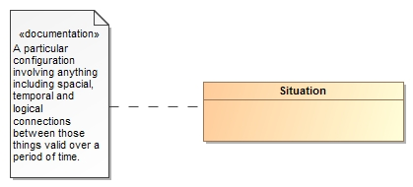
Threats and Risks of What?
A threat or risk is with respect to some undesirable situation
What is a situation?
We define a situation as a configuration of things…
People places, things, events, occurrences and the connections between them.
Some situations are consequences of others
Situations provide a link between different kinds and phases of threats & risks

Slide 4
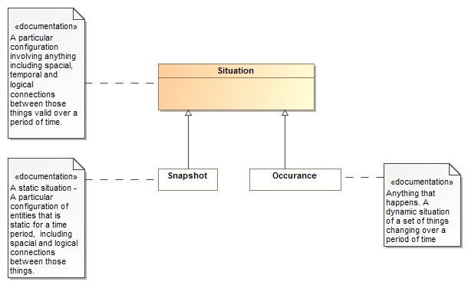
Situations can be a snapshot in time or an event occurring over time

Slide 5

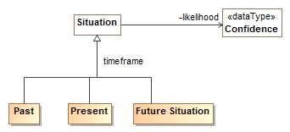
Situations Over Time
Situations can exist in the
Past (History)
Present (Current event)
Future (Expectation)
Situations have a likelihood
Past
Present
Future
Noting is for sure – so any situation can have a likelihood

Slide 6


Consequences
The same situation or kind of situation may be desired by some and unwanted by others based on the consequences
Consequences are relative to the objectives of one or more stakeholders
The impact of a consequence can be computed from the likelihood, degree of affect and importance
The desirability of any situation is the net of all the potential consequences.
Benefit
Don’t Care
Detriment

Slide 7
Classifying Situations across time and Consequence
Past
Present
Future
RISK
Benefit
Don’t Care
Detriment

Slide 8
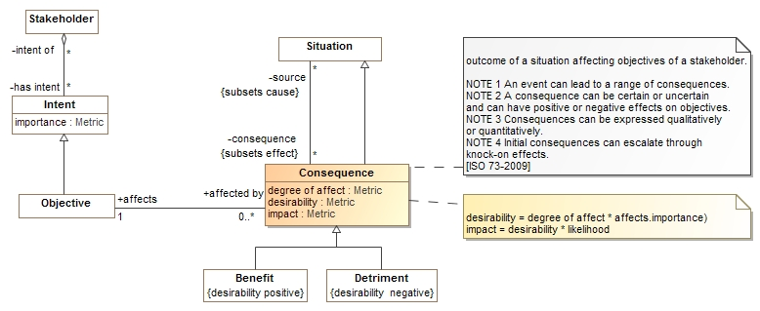
Consequence Model
Situations have consequences (an effect of the situation)
Consequence can be positive or negative: benefits or detriments, respectively
Consequences affect the objectives of stakeholders
This leads to the desirability of the consequence (positive or negative)
Desirability * likelihood provide the impact (→risk metric for detriments)

Slide 9
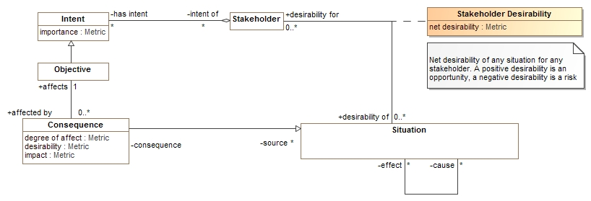
Desirability
The desirability of any situation for any stakeholder can then be computed based on the desirability of all consequences
“Risk” as a metric is a negative net desirability of a future situation

Slide 10
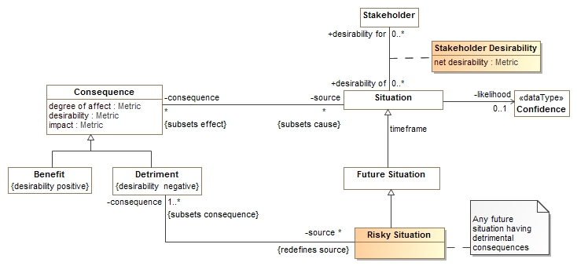
Risk
A risky situation is a future situation that has consequences that are a detriment to the objectives of some stakeholder
A risky situation (like all situations) have a net desirability for a stakeholder.
Risky situations correspond to the view of risks as situations or events
Net desirability (negative) corresponds to the view of risk as a metric

Slide 11
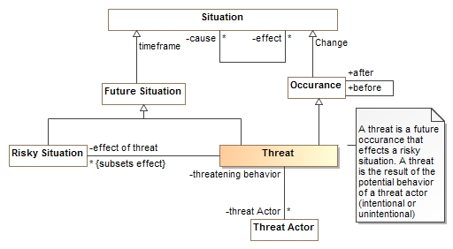
Threat
A threat is an occurrence that leads to a risky situation that is a potential behavior of a threat actor
A threat is not necessarily intentional

Slide 12
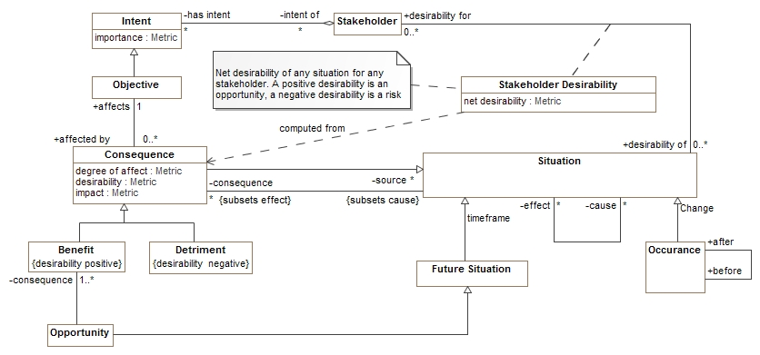
Opportunities
The opposite of a risky situation, opportunities have positive consequences – benefits.

Slide 13
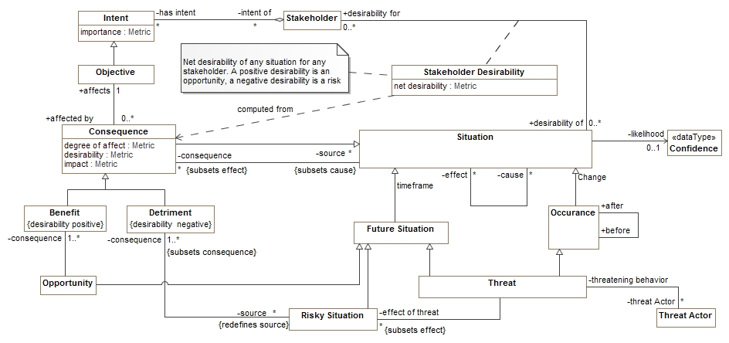
Putting threat and risk together
Note that a situation may be classified by multiple types

Slide 14
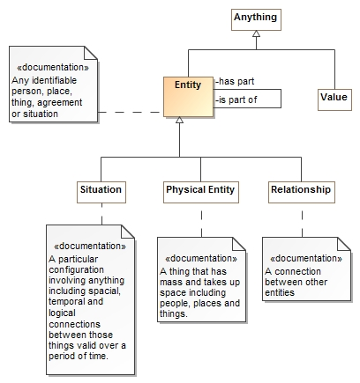
Entities
An entity is something you can identify, or name.
A situation is one kind of “Entity”.
Physical things are also entities
As are contracts, agreements and other relationships
Entities may have “parts” or be part of other things
Things that are not entities are values, like numbers.

Slide 15
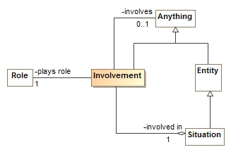
Involvement
Situations involve other things playing roles
The “involvement” relates a situation, the role played and the entity or value involved
Roles are types (categorizations) of things involved in situations
E.g. victim, perpetrator, weapon
Sometimes the actual thing playing the role is unknown, so the involved element is optional

Slide 16
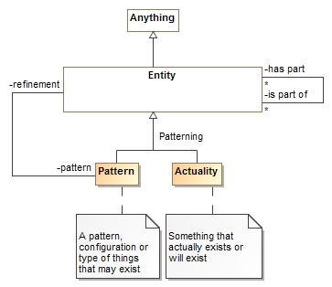
Patterns
Entities (including situations) may be actual things or events or patterns of them.
An “Actuality” is a real thing or something or a specific happening
A pattern can have a refinement (more specific configuration) that is another pattern or actuality
Everything true of a pattern must be true of its refinements.
Involved entities
Parts
Property Values
Rules
Situations can be used as patterns or actualities

Slide 17
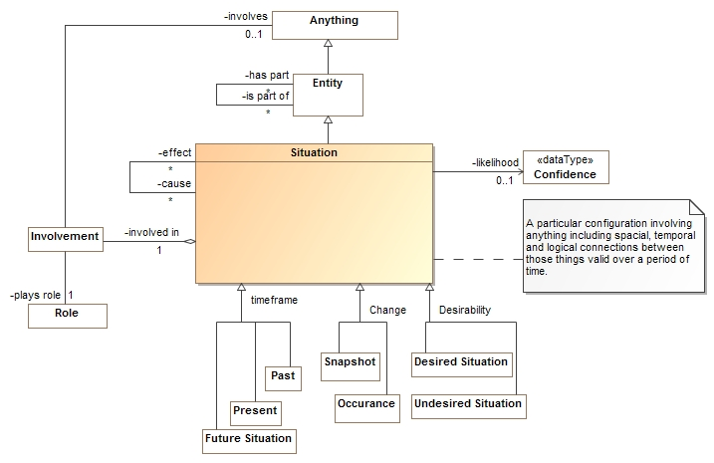
Summarizing Situations

Slide 18
Indicators

Slide 19
Indicator/Incident Scenario
Context
Power station “VA-1000” under motion & video surveillance
Surveillance station with security guard “Joe”
Sequence
Event 9001: (Automatic)
Motion alarm “VA-1000-M1” is triggered inside of VA-1000 fence
Location: VA-1000, North
Indicator: motion alarm inside substation
COA: (Automatic) notify security guard
Joe looks at Video feed and notices:
Man with gun inside VA-1000 fence
Joe records: Incident 9002:
Attaches related Event 9001 (Automatic)
Selects location: VA-1000
Selects indicator: Person with gun inside power station indicator
Indicates: Armed attack on substation TTP [75% Probability]
COA: (Automatic) Implied by “Person with gun inside power station” indicator
1: Check for authorized armed activities (automatic)
None found
2: Elevate Alarm (automatic)
3: Notify security detail (Manual)
Joe calls security detail
Security detail notifies Joe that a training exercise is going on today until 11PM, he should have been told
Joe enters authorized activity “Training-exercise 804” with start/end date & time at VA-1000
Joe marks incident 9002 as resolved, “Training-exercise 804” as reason.
Alarm canceled
Joe takes 10 cleansing breaths and gets some coffee

Slide 20
Enterprise Risk management vendors
http://www.metricstream.com/solutions/risk_management.htm
http://www.lockpath.com/
http://www.emc.com/security/rsa-archer.htm#!details
http://accelus.thomsonreuters.com/products/accelus-risk-manager?gclid=CJLb6s2Pp8ACFahj7Aod1Q8AJQ
http://www-03.ibm.com/software/products/en/openpages-operational-risk-management/
http://www.sap.com/pc/bp/eam/software/operational-risk-management/index.html

Slide 21
What is what?
Power station “VA-1000” | Place (Entity), Asset
Joe | Actor
Event 9001 (motion alarm inside substation) | Occurrence
COA: (Automatic) notify security guard | Course of Action
Incident 9002 (Joe sees man with gun) | Incident (Occurrence)
Person with gun inside power station indicator | Indicator (?)
-has->COA Elevate alarm | Automatic COA
-has->COA Check for authorization | Automatic COA
-has->Conditional COA: Call security detail | Course of Action
Alarm | Occurrence (or some subtype)
Training-exercise 804 | Occurrence (or some subtype)

